Slide 1

CSE 464 : Software Quality Assurance and Testing
Functional Testing I: Equivalent Classes
Janaka Balasooriya

Slide 2
Functional Testing (Specified Behavioral Testing) Approaches
Equivalent classes and Boundary Value Analysis
Use cases and Decision Table
State based testing
Domain Testing
Exploratory Testing
…………..Many more
Characteristics of a good test case [1]
It has a reasonable probability of finding a defect: Work backward and think about possible ways of failing a particular program
Its not redundant : No two test cases try to catch the same defect
It’s the best of its bread : Most suitable data set for a particular test

Slide 3
Equivalent Classes and Boundary Value Analysis
Chapter 5 and Chapter 6

Slide 4
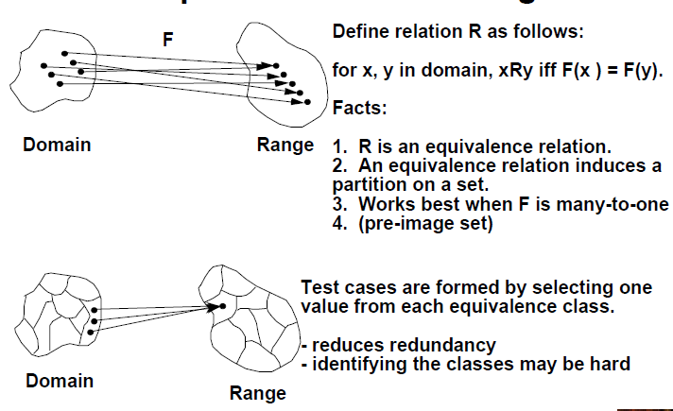
Equivalent Partition

Slide 5
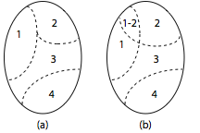
What is an Equivalent class?
They all test the same thing so if one catches a defect, others probably will
Thus, test case generation using equivalence class allows a tester to subdivide the input domain into a relatively small number of sub-domains, say N>1, as shown
In strict mathematical terms, the sub-domains by definition are disjoint. The four subsets shown in (a) constitute a partition of the input domain while the subsets in (b) are not. Each subset is known as an equivalence class.
Finding equivalent classes
Consider both valid and invalid inputs
Look for equivalent output events
Look for equivalent operating environments
Organize them in a table

Slide 6
Equivalent Partitioning (equivalent classes) – A Quick Review

Slide 7
Equivalent Partitioning Examples
Example 1
Consider an application that takes an integer denoted by age as its input. Let us suppose that the only legal values of age are in the range [1..120]. The set of input values is now divided into a set E containing all integers in the range [1..120] and a set U containing the remaining integers.
Further, assume that the application is required to process all values in the range [1..61] in accordance with requirement R1 and those in the range [62..120] according to requirement R2. Thus E is further subdivided into two regions depending on the expected behavior.
Similarly, it is expected that all invalid inputs less than or equal to 0 are to be treated in one way while all greater than 120 are to be treated differently. This leads to a subdivision of U into two categories.
Notes:
7

Slide 8
Example 2: Equivalence classes for variables: strings
Suppose you want to write test cases to test if variable names are valid for a given programming language that has following rules
Variable names must start with a letter.
Variable names can have uppercase letters, lowercase letters, digits and _.
Maximum length is 100 characters.
How can you partition the input string domain to test if a given variable name is valid?
Notes:
8

Slide 9
Example 3: Equivalence classes for variables: arrays
Suppose you want to test and application that reads integers stored in an array and count how many even numbers in the array
How can you partition the input domain to test this application?
Notes:
9

Slide 10
Equivalence classes for operating environments
When software is developed, usually we have a targeted OS, minimum memory requirements ..etc. So, look for equivalent classes based on operating environment also.
For example, if the program has been designed to work on a computer has between 64 and 256K of available memory, then
Equivalent classes are
Available memory is between 64-256 K
Available memory is less than 64 K
Available memory is larger than 256 K
Notes:
10

Slide 11
Equivalent Partitioning : Analysis

Slide 12
Classification of Equivalent Partitioning
Forms of Equivalence Class Testing (based on the textbook classification)
• Weak Normal: classes of valid values of inputs
• Strong Normal: Valid inputs one from each class
Weak Robust: classes of valid and invalid values of inputs (single fault assumption)
• Strong Robust: (multiple fault assumption) one from each class in Cartesian Product
Let’s compare these for a function of two variables, F(x1, x2)
• Extension to problems with 3 or more variables is not that difficult.

Slide 13
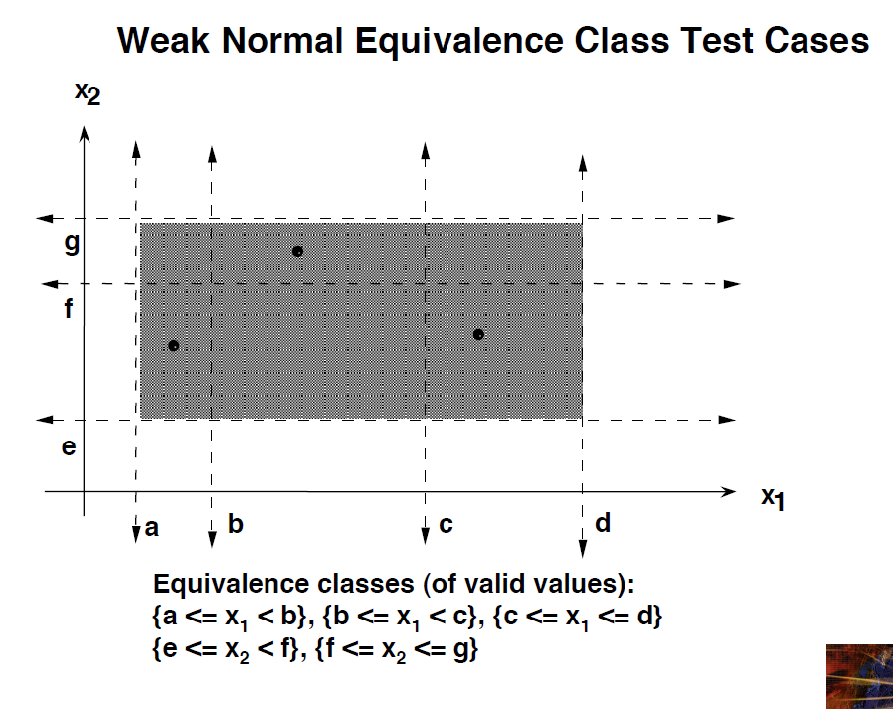
Weak Normal
• Identify equivalence classes of valid values.
• Test cases have all valid values.
• OK for regression testing.

Slide 14
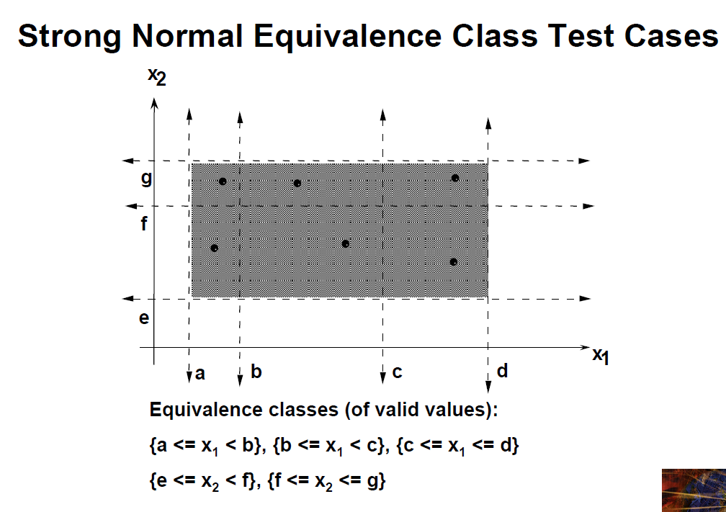
Identify equivalence classes of valid values.
• Test cases from Cartesian Product of valid values.
• Detects due to interactions with valid values of any number of variables.
• OK for regression testing, better for progression testing.

Slide 15
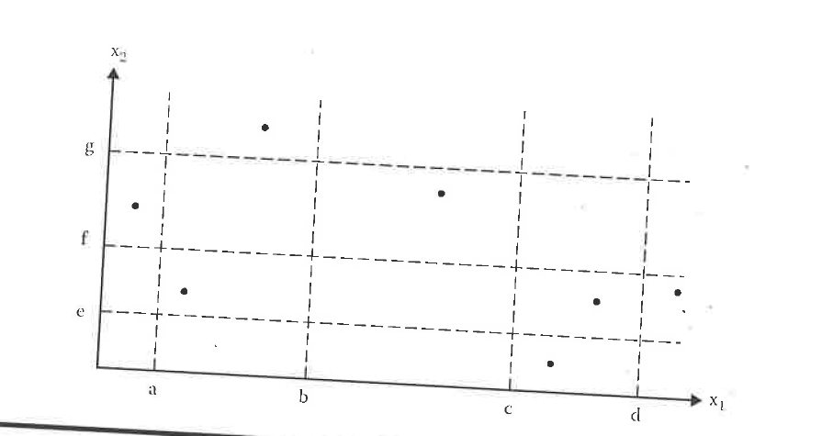
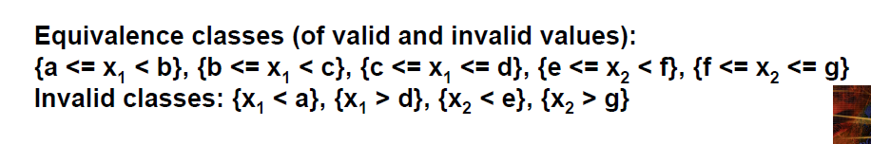
Weak Robust Equivalent Class Testing
Identify equivalence classes of valid and invalid values.
• Test cases have all valid values except one invalid value.
• OK for regression testing.

Slide 16
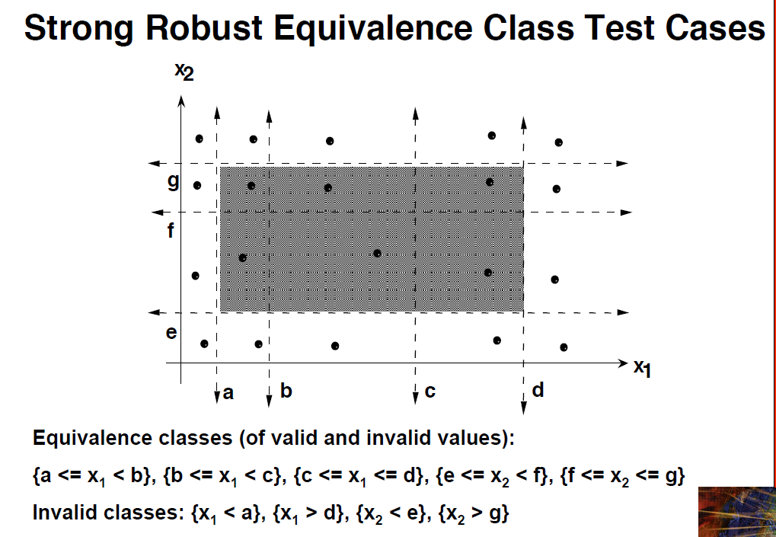
Identify equivalence classes of valid and invalid values.
• Test cases from Cartesian Product of all classes.
• Detects faults due to interactions with any values of any number of variables.

Slide 17
Another Partitioning Example
Consider an application that requires two integer inputs x and y. Each of these inputs is expected to lie in the following ranges: 3≤ x≤7, 7<x ≤ 15 and 5≤y≤9, 9<y≤20. No other constrains specified.
Design equivalent classes to test this application
Notes:
17

Slide 18
In-class activity
Will be assigned during the class time

Slide 19
Junit Demo – In-class

Slide 20
Next Time
Meanwhile Something to work on (No submission requited, we will use this as one of the examples in designing test cases)
Triangle program accepts three integers a, b, and c as inputs. These are taken to be sides of a triangle. The output of the program is the type of triangle determined by the three sides: Equilateral, Isosceles, Scalene, or Not A Triangle. In addition 1 <= a <= 200, 1 <= b <= 200, and 1 <= c <= 200.
Also, to be a triangle sum of any two sides should be greater than the other side ( a < b +c , c < a + b, b < a +c ).
a) How do you plan to test this program?
b) Design test cases based on your plan

Slide 21
Next Time
Analysis of the Triangle problem
Boundary value analysis

